Slide 1
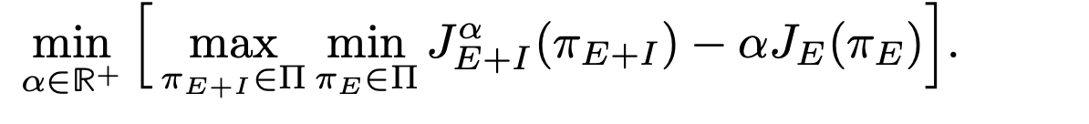
Implementation Overview
Maintain two policies: task-only (policy_E) and mixed task+disc (policy_{E+I}) — from Eq. 5's min-max dual
Alternate training stages: min-stage trains policy_E on task reward, max-stage trains policy_{E+I} on combined reward — Section 3.2, Eqs. 6 and 9
https://arxiv.org/pdf/2211.07627

Slide 2
Min and Max Stage Brief Explanation
Min-stage: π_{E+I} rolls out, π_E gets updated on task reward only — building the baseline
Max-stage: π_E rolls out, π_{E+I} gets updated on combined task+disc reward — improving the main policy while meeting the baseline

Slide 3
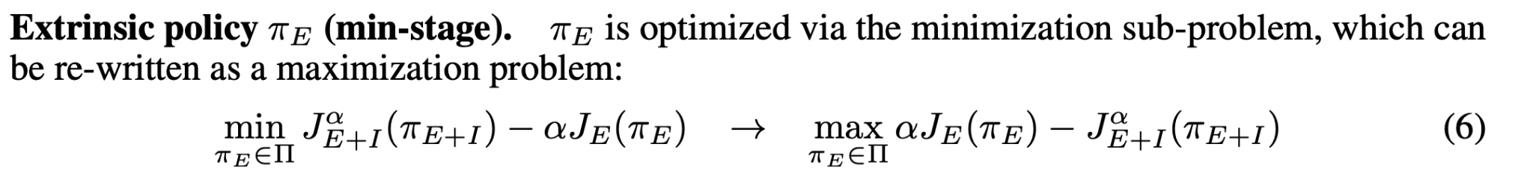
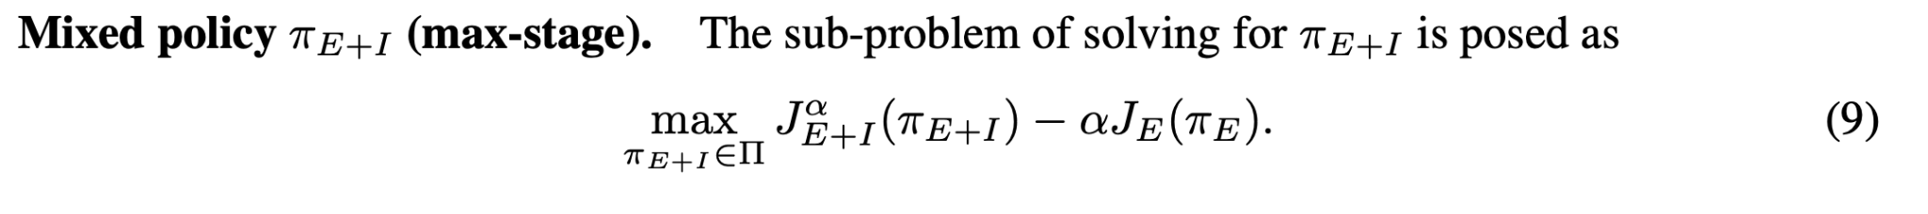
Min Stage and Max Stage Implementation
Alternate training stages: min-stage trains policy_E on task reward, max-stage trains policy_{E+I} on combined reward — Section 3.2, Eqs. 6 and 9

Slide 4
Dynamic Updates of alpha parameter
Lagrangian multiplier alpha dynamically reweights task vs discriminator: mixed policy behind on task → alpha goes up → then the discriminator is suppressed; mixed ahead → alpha goes down down → discriminator gets more influence
Eq. 4, updated via Eq. 12

Slide 5
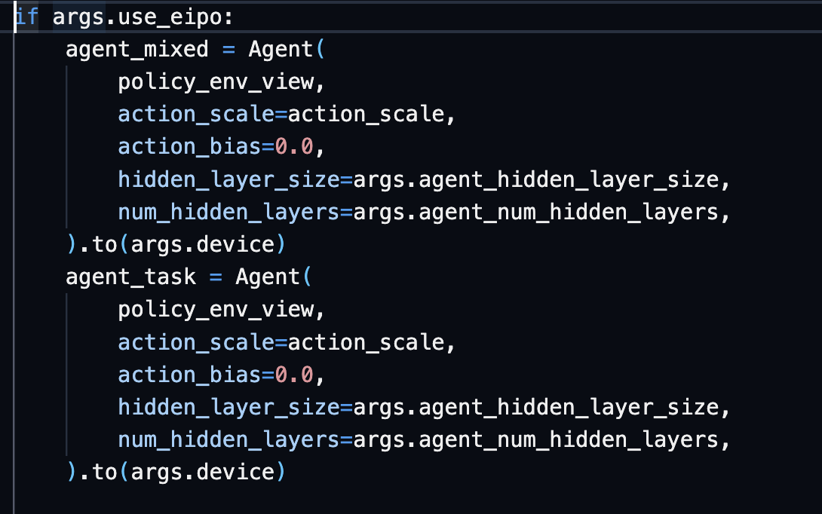
Two Policies Used
If a model path is provided, then they are initialized with it and then they diverge during training

Slide 6
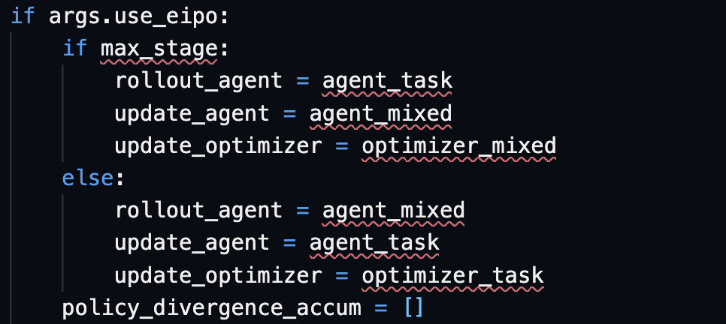
Min Max Schedule for the task and mixed policy

Slide 7
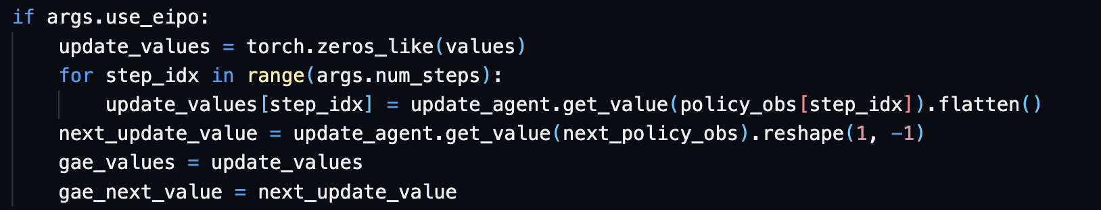
Cross Policy Value Updating
Standard PPO: same policy rolls out and updates, so rollout values are correct for GAE
EIPO: different policy rolls out vs updates — rollout agent's values are the wrong baseline
Paper's Eqs. 7–10 use cross-policy value functions (e.g. U_min uses V_{E+I} for pol_E's advantages)
Impl: re-run the update agent's value network on stored observations before computing GAE
Passed into the same GAE loop at the training for normal amp_training

Slide 8
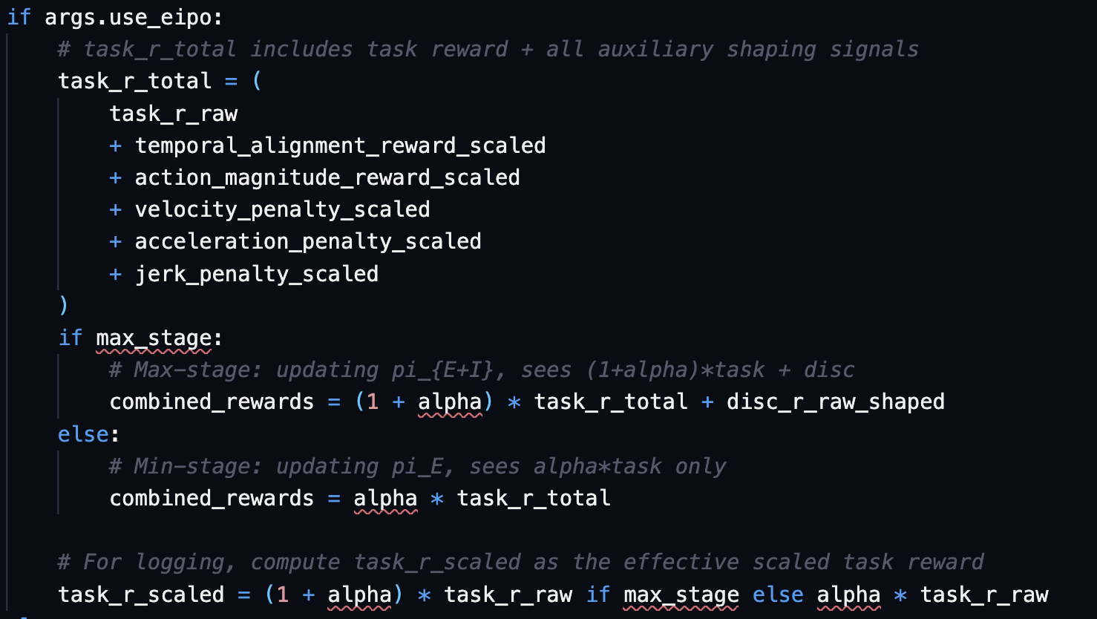
Mixed Reward Weighting instead of fixed 0.5/0.5

Slide 9
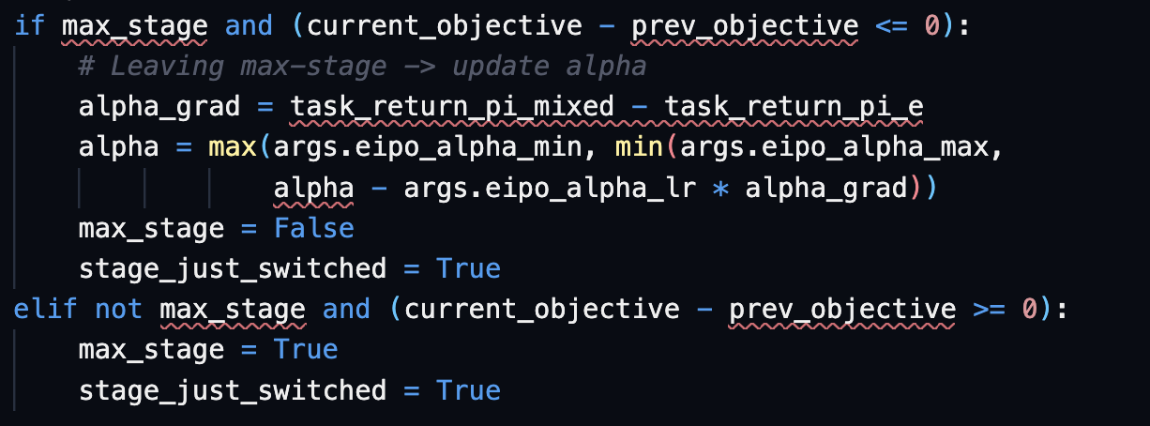
Switching stages and updating the alpha parameter
Each stage runs until the dual objective stops improving, then switches
alpha only updates when leaving max-stage, using the task performance gap as the gradient
Mixed ahead on task → alpha decreases → discriminator gets more influence
Mixed behind on task → alpha increases → discriminator gets suppressed

Slide 10
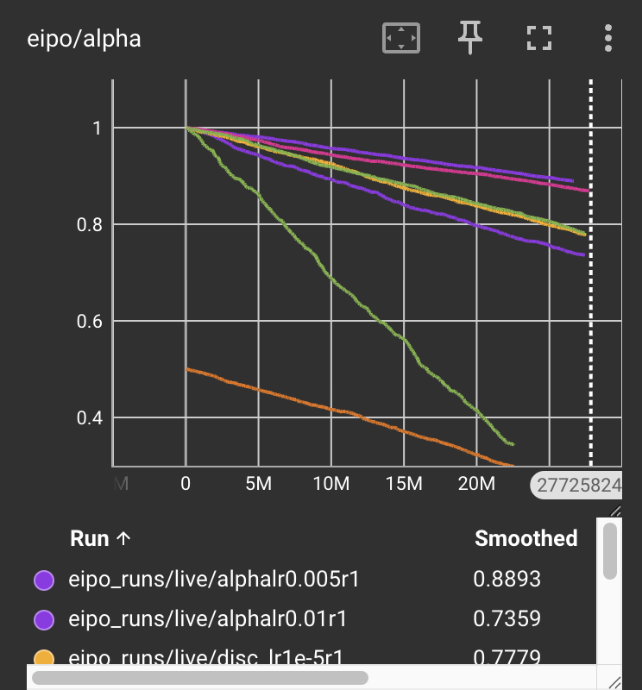
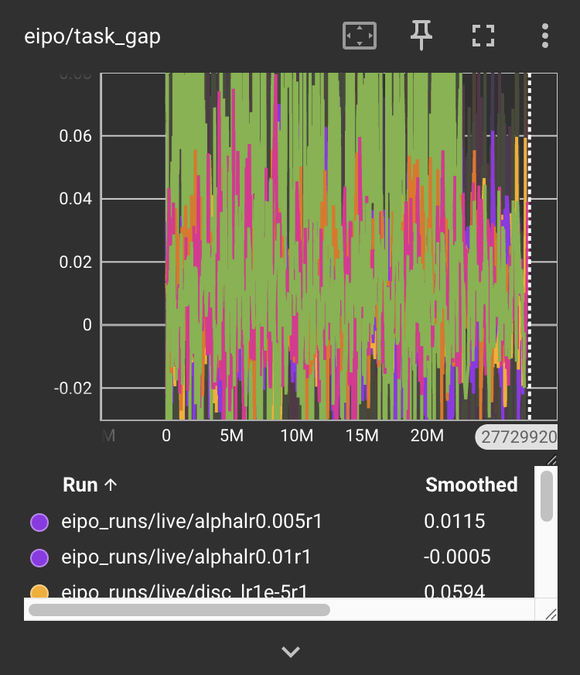
Results
If the task policy is good, then the alpha parameter should rise when the task policy outperforms the mixed policy → is this an exploration issue for the task policy?
The gap between the two policies is essentially the same, so the task policy never pulls ahead of the mixed one

Slide 11
Several Discriminator Modes
Live: Rewards come directly from discriminator during training
Target: Rewards come from a slow moving EMA copy (each training iteration is a weighted average of the live snapshot and the target controlled by a tau parameter)
Snapshot: Comes from a frozen copy every time they switch from min to max stages

Slide 12
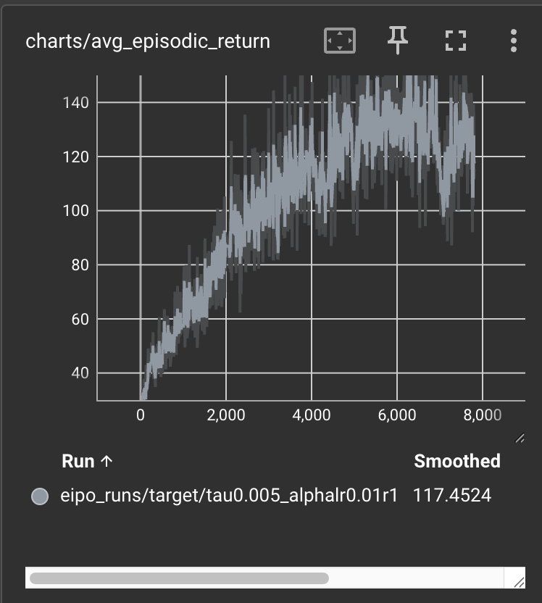
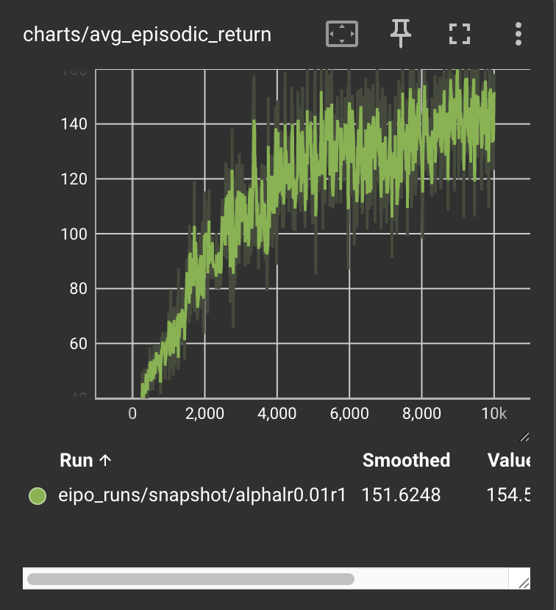
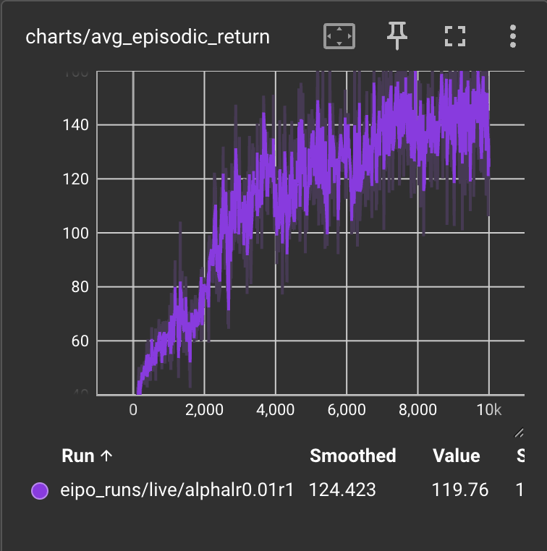
Avg Return per Episode Results

Slide 13
Gif Comparison EIPO
Snapshot: a_lr = 0.01
Live: a_lr = 0.01
Target: tau = 0.001 and a_lr = 0.01
Task Only

Slide 14
Difference from paper
Paper uses RND (novelty-based exploration bonus) as the auxiliary reward — it's not optimized (just fixed)
Our auxiliary reward is a discriminator trained in a GAN loop — it's optimized during training, tells paddle what good movements should look like instead of the up and down motion we see without it

